Slide 1
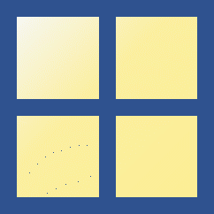




Scope of numeric type variables
multi-dimensional arrays
(e.g., tensor)
$$m×n×l⋯$$
Numeric
matrix
$$m×n$$
vector
$$n×1$$
scalar
$$1×1$$

Slide 2
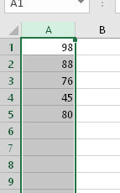
Examples of vector
Exam scores
Sound Signals
Images

